Slide 1
SYRIA-TELCOM
CUSTOMER CHURN ANALYSIS
CYNTHIA CHIURI

Slide 2
01
BUSINESS UNDERSTANDING

Slide 3
BUSINESS UNDERSTANDING
For the telecommunication industry, one of the most important metrics to monitor and optimize is the churn rate, which measures the percentage of customers who stop using the service within a given period.
A high churn rate indicates customer dissatisfaction, loss of revenue, and reduced market share.
Therefore, it is essential to investigate the factors that influence customer churn and develop predictive models that can identify customers who are at risk of leaving.

Slide 4
FORMULATED BUSINESS PROBLEMS
A
B
C
What patterns and insights can we uncover in customer behaviour that would enable early identification of customers who are likely to churn, allowing us to implement proactive interventions?
Create a precise binary classification model to accurately predict customer churn and effectively reduce customer attrition?
How can we assist Syria-Tel in optimizing retention strategies and resource allocation to minimize financial losses associated with customer churn, ultimately improving the company's bottom line and fostering customer loyalty?

Slide 5
02
DATA UNDERSTANDING

Slide 6
DATA OBSERVATIONS
Below is what we found in the data understanding analysis:
The dataset contains 3333 entries and 21 columns.
The columns represent various customer attributes, including state, account length, area code, phone number, international plan, voice mail plan, number of voice mail messages, call durations and charges for different time periods and international calls, customer service calls, and churn status.
The dataset does not have any missing values, as indicated by the non-null counts.
The data types of the columns include bool, float64, int64, and object.
The bool column represents the churn status, indicating whether a customer discontinued the service (True) or not (False).
The float64 columns represent numerical values for call durations and charges.
The int64 columns represent numerical values for account length, area code, number of voice mail messages, call counts and customer service calls.
The object columns include state, phone number, international plan, and voice mail plan, which are categorical variables.

Slide 7
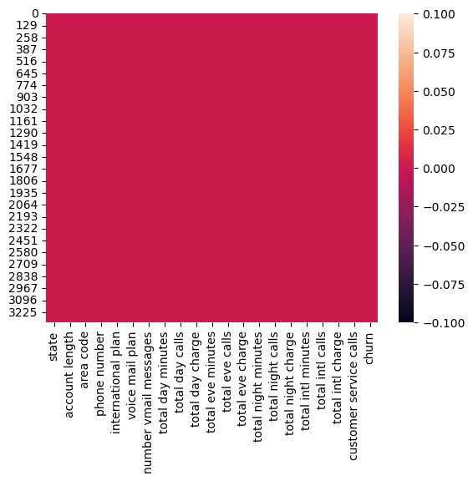
OBSERVATIONS
The data contained zero missing values and zero null values

Slide 8
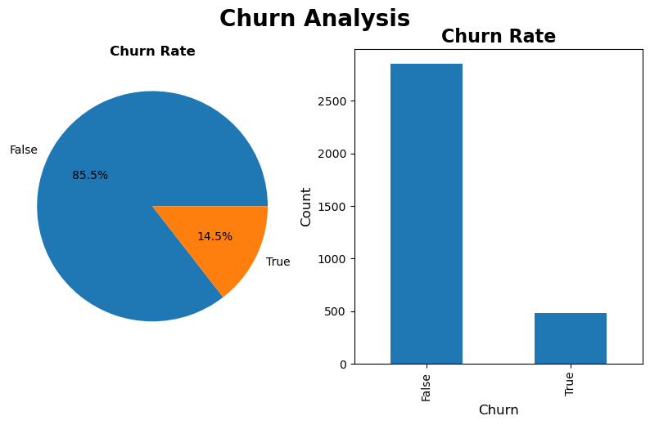
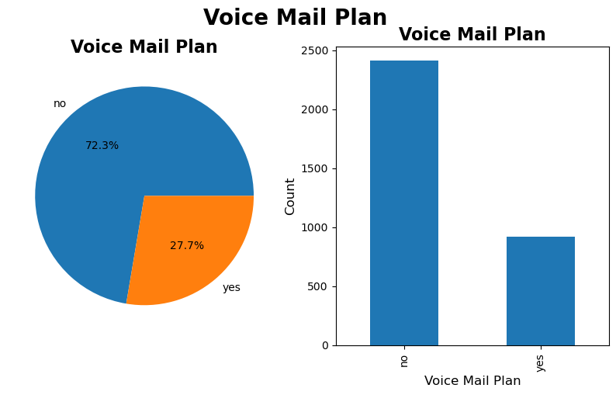
OBSERVATIONS
From above, we note that there is a low churn rate of around 15%,therefore,loyalty for the Syria telco is high.
A customer is less likely to churn if he has a voice mail plan and we observe that the voice mail plan is only at 27.7%.

Slide 9
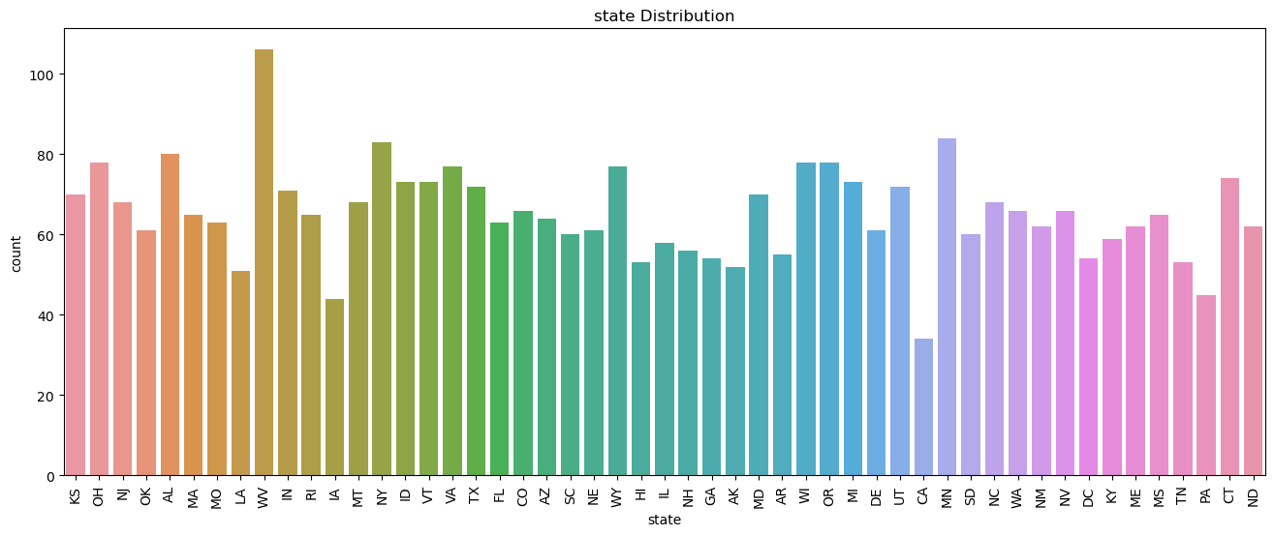
OBSERVATIONS
The state with the highest count is West Virginia (WV) with 106 occurrences, indicating it is the most frequent state in the dataset. Minnesota (MN) follows closely with 84 occurrences, making it the second most common state.

Slide 10
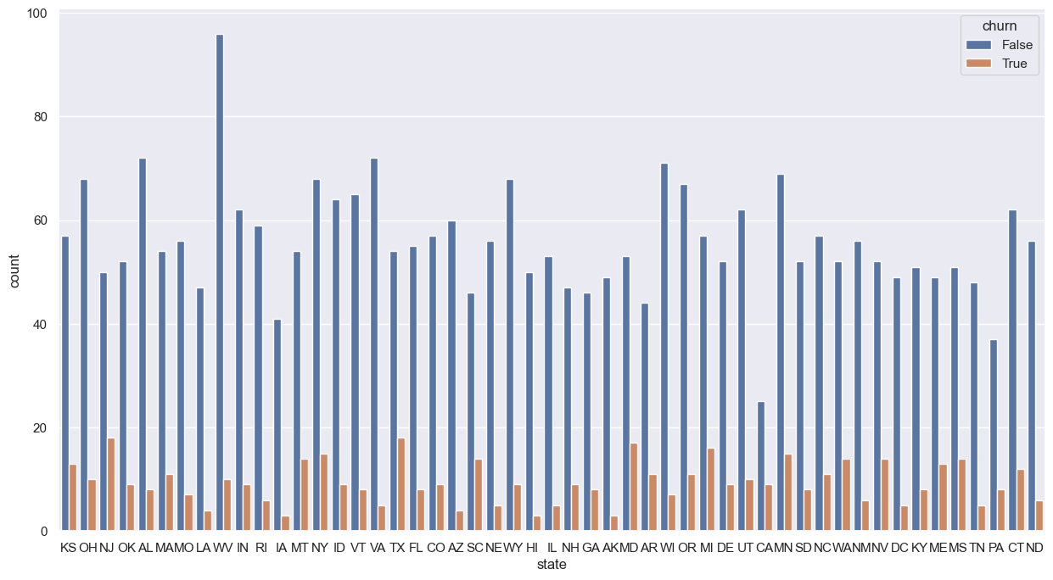
OBSERVATIONS
The above shows different cities with different churn rates and the churn rate is low for most states.

Slide 11
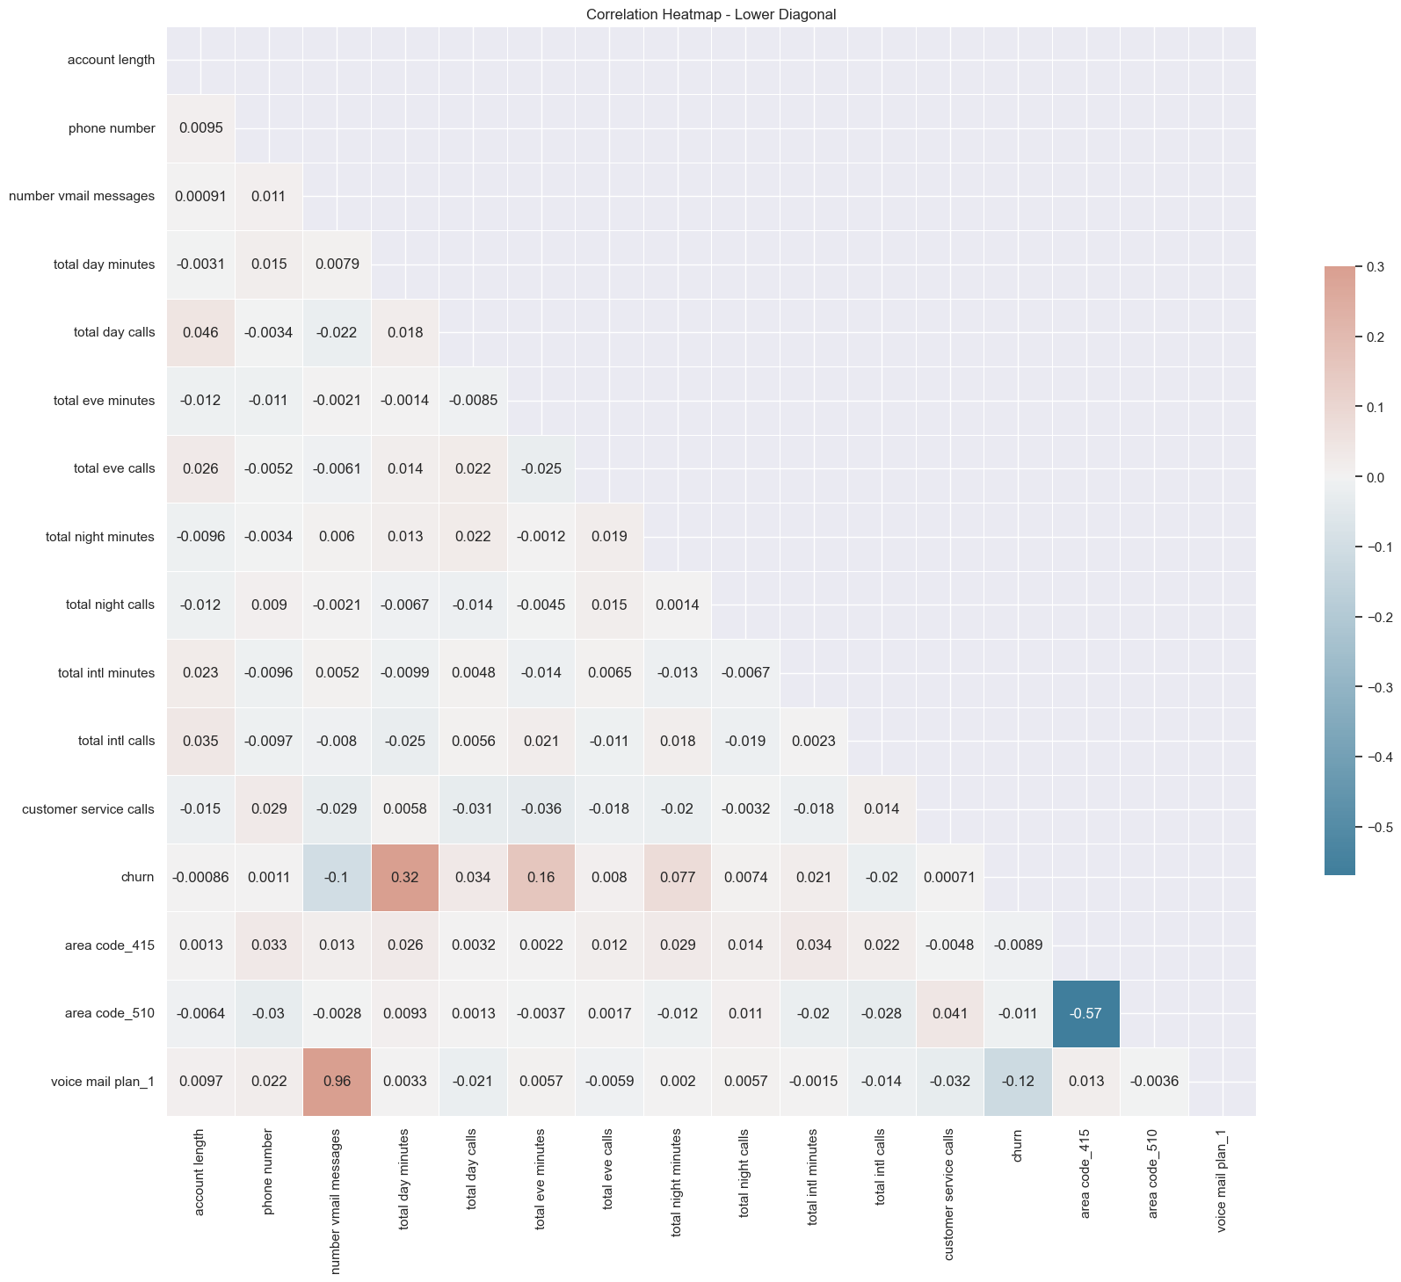
OBSERVATIONS
The above shows the collinearity analysis between the variables after reducing multicollinearity.

Slide 12
03
MODELLING

Slide 13
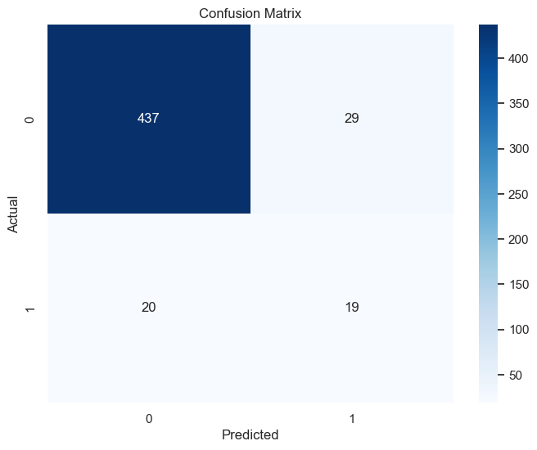
BASELINE MODEL –DECISION TREE
The above shows different cities with different churn rates and the churn rate is low for most states.

Slide 14
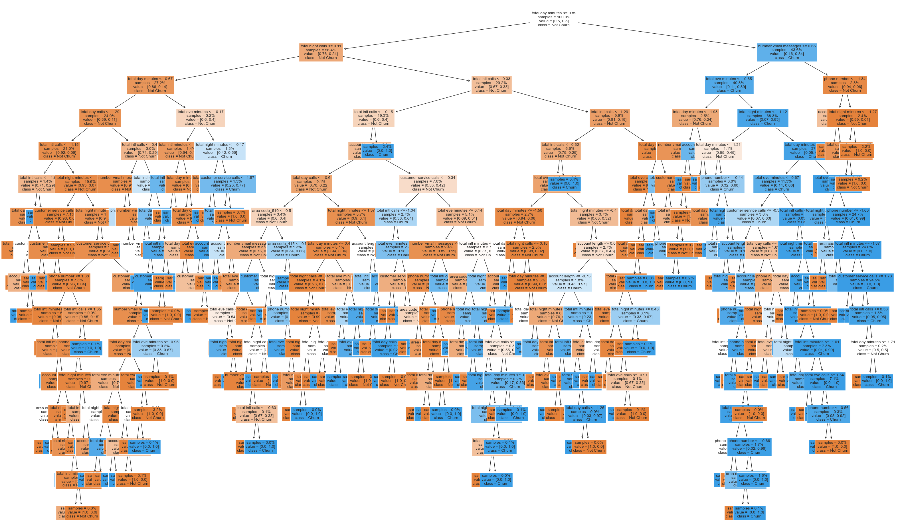
BASELINE MODEL –DECISION TREE

Slide 15
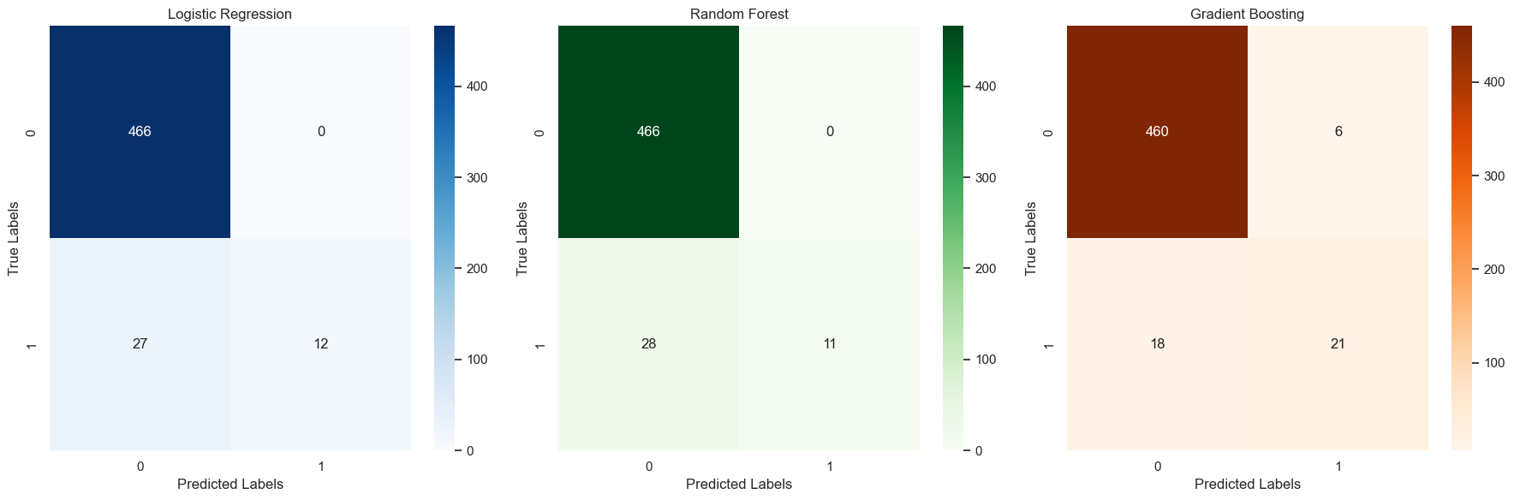
MODELS USED

Slide 16
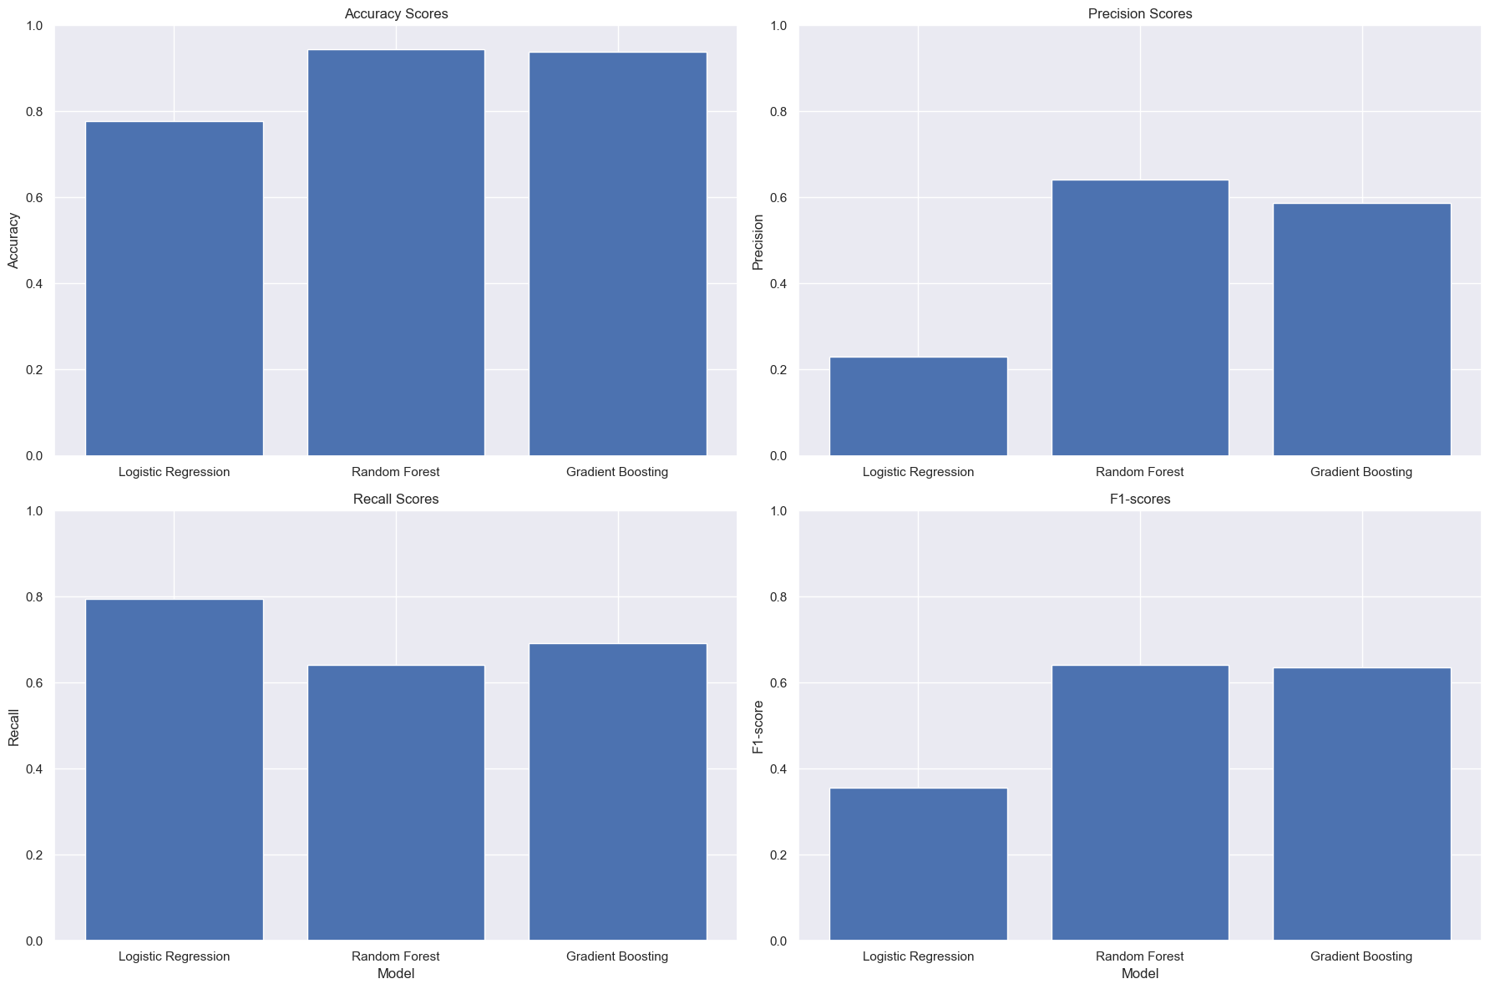
MODEL SCORES PERFORMANCE

Slide 17
We can see from the feature importance graph below that there are several features that the model is weighing more heavily: Total day minutes, Total intl calls, Total Eve minutes, Number of Vmail messages, Account length.

Slide 18
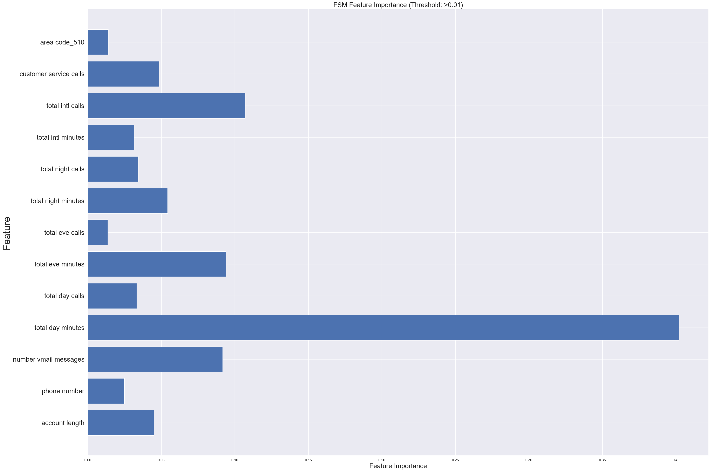
FEATURE SELECTION

Slide 19
CONLUSION
The churn prediction models seem to have reasonably good performance based on the metrics used (accuracy, precision, recall, and F1-score), with Gradient Boosting performing the best with an Accuracy of 95.25% and Recall of 53.8% after tuning.

Slide 20
RECOMMENDATIONS
Based on our findings, we recommend the following:
To answer our objective question:
How can we assist SyriaTel in optimizing retention strategies and resource allocation to minimize financial losses associated with customer churn, ultimately improving the company's bottom line and fostering customer loyalty?
Revise International Plan Pricing: Adjust the pricing structure of the International Plan to align with the standard plan, as the current charges are identical.
Enhance Communication Channels: Establish proactive communication strategies to engage customers and address their needs promptly.
Implement Regular Feedback Mechanisms: Frequently solicit customer feedback to understand their experiences and expectations better.
Introduce Periodic Customer Incentives: Deploy regular promotional offers to enhance customer loyalty and retention.
Focus on High-Churn States: Pay special attention to customers in states with high churn rates and devise strategies to address their specific issues.
Prioritize High-Value Customers: Develop strategies to deepen relationships with the most loyal and profitable customers.
Ensure Regular Server Maintenance: Conduct routine server maintenance to ensure optimal performance and minimize downtime.
Address Network Connectivity Issues: Invest in infrastructure improvements to resolve any existing network connectivity problems.
Develop a New Customer Onboarding Roadmap: Create a comprehensive roadmap for new customers to ensure a smooth and positive onboarding experience.
Perform Churn Analysis: Conduct regular churn analysis to identify patterns and devise effective retention strategies.
Maintain Competitive Edge: Continually monitor market trends and competitor activities to ensure the company’s offerings remain competitive.

Slide 21
THANK YOU

